Slide 1
Quick-Sort
7 4 9 6 2 → 2 4 6 7 9
4 2 → 2 4
7 9 → 7 9
2 → 2
9 → 9
Quick-Sort
Notes:
Quick-Sort

Slide 2
Quicksort
Invented by Sir Charles A. R. Hoare
  British computer scientist
  1980 ACM Turing Award
  Major contributions to developing computer languages
  “I conclude that there are two ways of constructing a software design: one way is to make it so simple that there are obviously no deficiencies and the other way is to make it so complicated that there are no obvious deficiencies."
  C. A. R. Hoare

Slide 3
Quicksort
Fastest known sorting algorithm in practice
  Caveat: not stable
Average case complexity O(N log N )
Worst-case complexity O(N²)
  Rarely happens, if coded correctly

Slide 4
Quicksort Outline
Divide and conquer approach
Given array S to be sorted
  If size of S < 1 then done;
  Pick any element v in S as the pivot
  Partition S-{v} (remaining elements in S) into two groups
    S1 = {all elements in S-{v} that are smaller than v}
    S2 = {all elements in S-{v} that are larger than v}
  Return {quicksort(S1) followed by v followed by quicksort(S2) }
Trick lies in handling the partitioning (step 3).
  Picking a good pivot
  Efficiently partitioning in-place

Slide 5
Quicksort example
81
43
31
57
75
13
92
65
26
0
Select pivot
81
43
31
57
75
13
65
26
0
92
partition
13
31
57
65
81
43
26
0
92
75
Recursive call
Recursive call
0
13
26
31
43
57
75
81
92
Merge
0
13
26
31
43
57
65
75
81
92

Slide 6
Partitioning Algorithm
Original input : S = {6, 1, 4, 9, 0, 3, 5, 2, 7, 8}
Get the pivot out of the way by swapping it with the last element
Have two ‘iterators’ – i and j
  i starts at first element and moves forward
  j starts at last element and moves backwards
8 1 4 9 0 3 5 2 7 6
pivot
8 1 4 9 0 3 5 2 7 6
pivot
i
j

Slide 7
Partitioning Algorithm (contd.)
While (i < j)
  Move i to the right till we find a number greater than pivot
  Move j to the left till we find a number smaller than pivot
  If (i < j) swap(S[i], S[j])
  (The effect is to push larger elements to the right and smaller elements to the left)
Swap the pivot with S[i]

Slide 8
Partitioning Algorithm Illustrated
i
j
pivot
8 1 4 9 0 3 5 2 7 6
Move
i
j
pivot
8 1 4 9 0 3 5 2 7 6
swap
i
j
pivot
2 1 4 9 0 3 5 8 7 6
move
i
j
pivot
2 1 4 9 0 3 5 8 7 6
swap
i
j
pivot
2 1 4 5 0 3 9 8 7 6
move
j
i
pivot
i and j
have crossed
2 1 4 5 0 3 9 8 7 6
Swap S[i]
with pivot
2 1 4 5 0 3 6 8 7 9
j
i
pivot

Slide 9
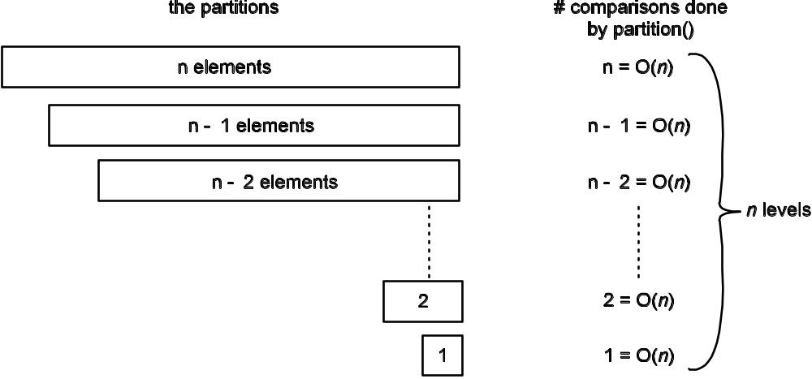
Quick Sort: Using A “Bad” Pivot
If the pivot always produces one empty partition and one with n – 1 elements, there will be n levels, each of which requires O(n) comparisons
O(n²) time complexity

Slide 10
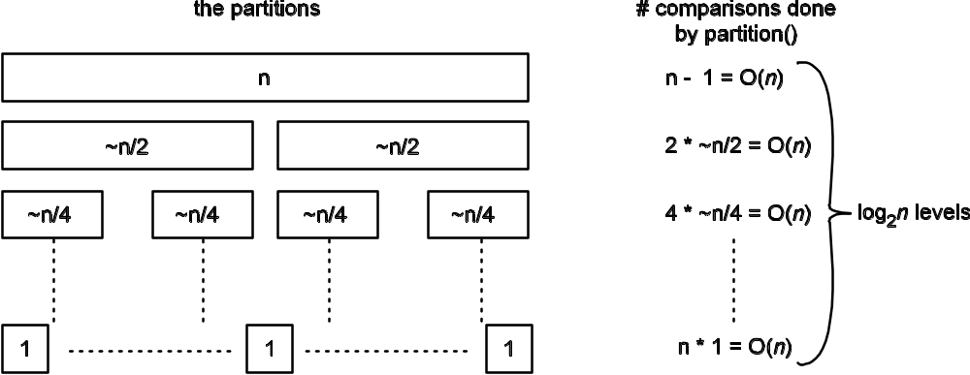
Quick Sort: Using A “Good” Pivot
If the pivot “evenly” splits the partition, there will be log₂n levels, each of which requires O(n) comparisons
O(nlog₂n) time complexity

Slide 11
Picking the Pivot
How would you pick one?
Strategy 1: Pick the first element in S
  Works only if input values are distributed uniformly
  What if input S is sorted, or even mostly sorted?
    All the remaining elements would go into either S1 or S2!
    Terrible performance
  Why worry about sorted input?
    Remember → Quicksort is recursive, so sub-problems could be sorted
    Plus mostly sorted input is quite frequent

Slide 12
Picking the Pivot (contd.)
Strategy 2: Pick the pivot randomly
  Would usually work well, even for mostly sorted input
  Unless the random number generator is not quite random!
  Plus random number generation is an expensive operation

Slide 13
Picking the Pivot (contd.)
Strategy 3: Median-of-three Partitioning
  Ideally, the pivot should be the median of input array S
    Median = element in the middle of the sorted sequence
  Would divide the input into two almost equal partitions
  Unfortunately, the median is hard to calculate quickly without sorting first!
  So find the approximate median
    Pivot = median of the left-most, right-most and center element of the array S
    Solves the problem of sorted input

Slide 14
Picking the Pivot (contd.)
Example: Median-of-three Partitioning
  Let input S = {6, 1, 4, 9, 0, 3, 5, 2, 7, 8}
  left=0 and S[left] = 6
  right=9 and S[right] = 8
  center = (left+right)/2 = 4 and S[center] = 0
  Pivot
    = Median of S[left], S[right], and S[center]
    = median of 6, 8, and 0
    = S[left] = 6

Slide 15
Pivot – Median of Three
Compare just three elements: the leftmost, rightmost and center
Swap these elements if necessary so that
  A[left] Smallest
  A[right] Largest
  A[center] Median of three
Pick A[center] as the pivot
Swap A[center] and A[right – 1] => pivot is at 2nd last position

Slide 16
Pivot – Median of Three
2
5
6
4
13
3
12
19
6
A[left] = 2, A[center] = 13, A[right] = 6
2
5
6
4
6
3
12
19
13
Swap A[center] and A[right]
2
5
6
4
6
3
12
19
13
Choose A[center] as pivot
pivot
2
5
6
4
19
3
12
6
13
Swap pivot and A[right – 1]
pivot
Now we only need to partition A[left + 1, …, right – 2].

Slide 17
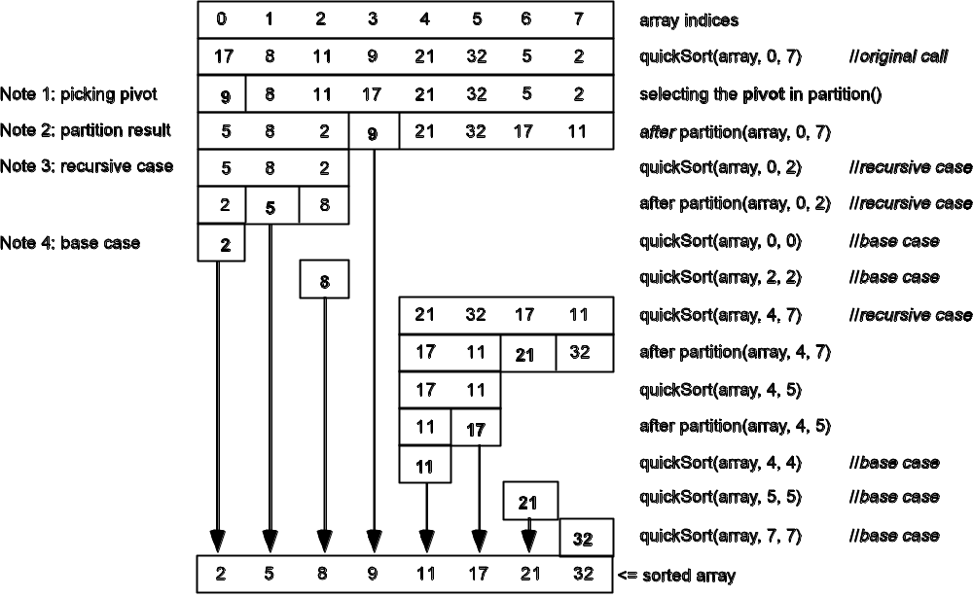
Quick Sort: An Example

Slide 18
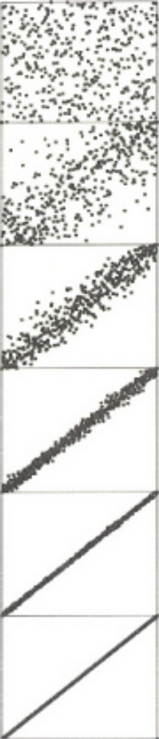
Quicksort – Pictorial Representation
Array is successively subdivided around partitioning element
Within each section, items are arranged randomly

Slide 19
Quick-Sort (from Text Book)
Quick-sort is a randomized sorting algorithm based on the divide-and-conquer paradigm:
  Divide: pick a random element x (called pivot) and partition S into
    L elements less than x
    E elements equal x
    G elements greater than x
  Recur: sort L and G
  Conquer: join L, E and G
x
x
L
G
E
x
Quick-Sort

Slide 20
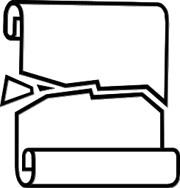
Partition
We partition an input sequence as follows:
  We remove, in turn, each element y from S and
  We insert y into L, E or G, depending on the result of the comparison with the pivot x
Each insertion and removal is at the beginning or at the end of a sequence, and hence takes O(1) time
Thus, the partition step of quick-sort takes O(n) time
Algorithm partition(S, p)
Input sequence S, position p of pivot
Output subsequences L, E, G of the
elements of S less than, equal to,
or greater than the pivot, resp.
L, E, G ← empty sequences
  x ← S.remove(p)
  while ¬S.isEmpty()
  y ← S.remove(S.first())
  if y < x
  L.addLast(y)
  else if y = x
  E.addLast(y)
  else { y > x }
  G.addLast(y)
  return L, E, G
Quick-Sort

Slide 21
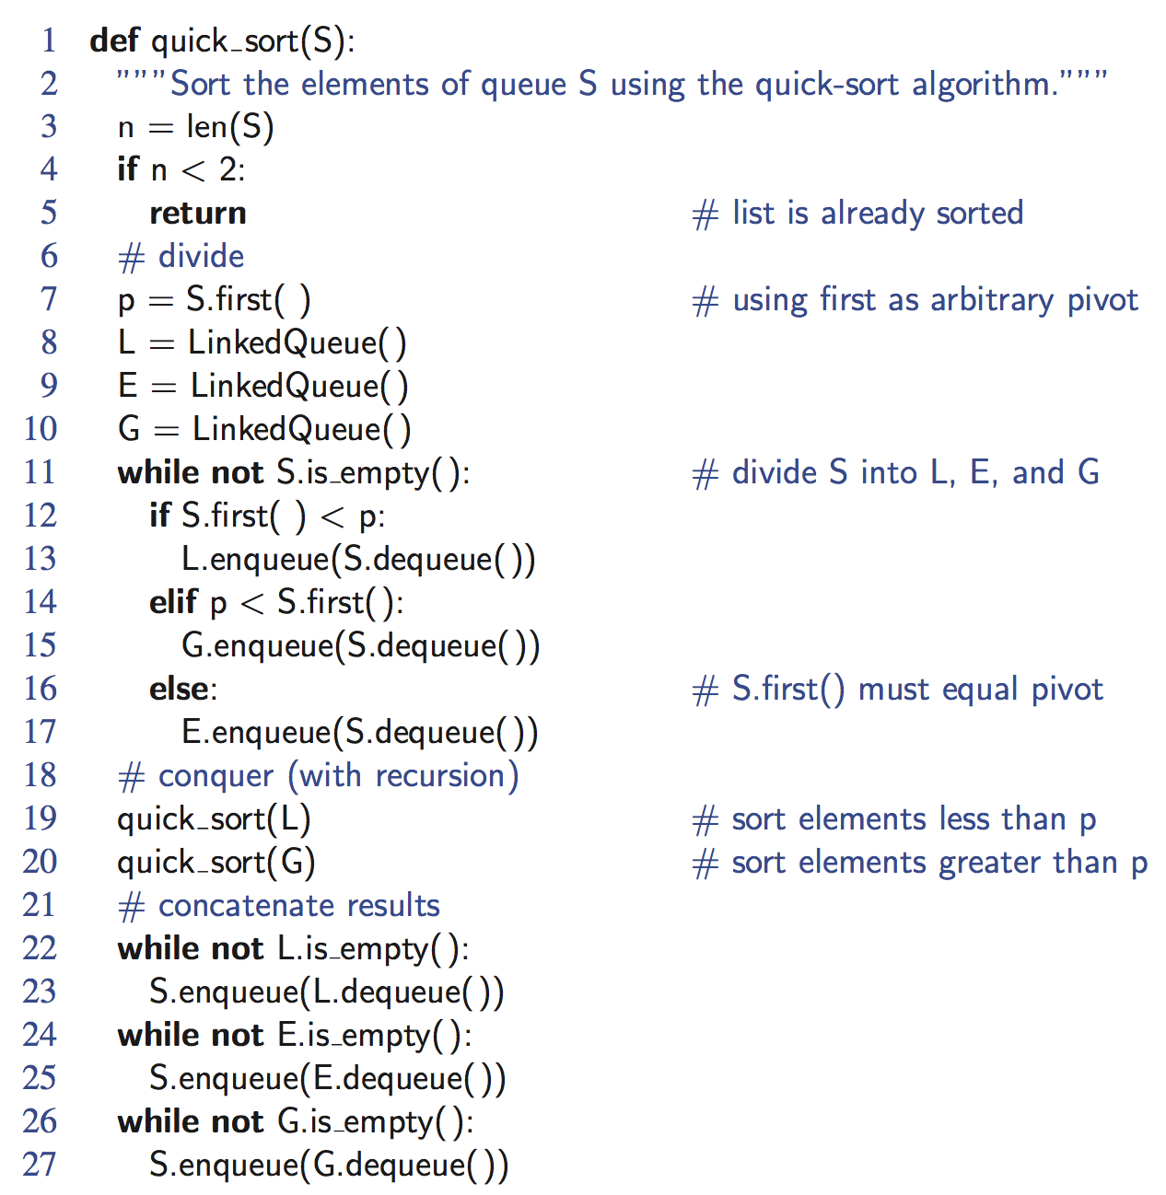
Python Implementation
Quick-Sort

Slide 22
Quick-Sort Tree
An execution of quick-sort is depicted by a binary tree
  Each node represents a recursive call of quick-sort and stores
    Unsorted sequence before the execution and its pivot
    Sorted sequence at the end of the execution
  The root is the initial call
  The leaves are calls on subsequences of size 0 or 1
7 4 9 6 2 → 2 4 6 7 9
4 2 → 2 4
7 9 → 7 9
2 → 2
9 → 9
Quick-Sort

Slide 23
Execution Example
Pivot selection
7 2 9 4 3 7 6 1 → 1 2 3 4 6 7 8 9
7 2 9 4 → 2 4 7 9
3 8 6 1 → 1 3 8 6
2 → 2
9 4 → 4 9
3 → 3
8 → 8
9 → 9
4 → 4
Quick-Sort

Slide 24
Execution Example (cont.)
Partition, recursive call, pivot selection
7 2 9 4 3 7 6 1 → 1 2 3 4 6 7 8 9
2 4 3 1 → 2 4 7 9
3 8 6 1 → 1 3 8 6
2 → 2
9 4 → 4 9
3 → 3
8 → 8
9 → 9
4 → 4
Quick-Sort

Slide 25
Execution Example (cont.)
Partition, recursive call, base case
7 2 9 4 3 7 6 1 → → 1 2 3 4 6 7 8 9
2 4 3 1 →→ 2 4 7
3 8 6 1 → 1 3 8 6
1 → 1
9 4 → 4 9
3 → 3
8 → 8
9 → 9
4 → 4
Quick-Sort

Slide 26
Execution Example (cont.)
Recursive call, …, base case, join
7 2 9 4 3 7 6 1 → 1 2 3 4 6 7 8 9
2 4 3 1 → 1 2 3 4
3 8 6 1 → 1 3 8 6
1 → 1
4 3 → 3 4
3 → 3
8 → 8
9 → 9
4 → 4
Quick-Sort

Slide 27
Execution Example (cont.)
Recursive call, pivot selection
7 2 9 4 3 7 6 1 → 1 2 3 4 6 7 8 9
2 4 3 1 → 1 2 3 4
7 9 7 1 → 1 3 8 6
1 → 1
4 3 → 3 4
8 → 8
9 → 9
9 → 9
4 → 4
Quick-Sort

Slide 28
Execution Example (cont.)
Partition, …, recursive call, base case
7 2 9 4 3 7 6 1 → 1 2 3 4 6 7 8 9
2 4 3 1 → 1 2 3 4
7 9 7 1 → 1 3 8 6
1 → 1
4 3 → 3 4
8 → 8
9 → 9
9 → 9
4 → 4
Quick-Sort

Slide 29
Execution Example (cont.)
Join, join
7 2 9 4 3 7 6 1 → 1 2 3 4 6 7 7 9
2 4 3 1 → 1 2 3 4
7 9 7 → 17 7 9
1 → 1
4 3 → 3 4
8 → 8
9 → 9
9 → 9
4 → 4
Quick-Sort

Slide 30

In-Place Quick-Sort
Quick-sort can be implemented to run in-place
In the partition step, we use replace operations to rearrange the elements of the input sequence such that
  the elements less than the pivot have rank less than h
  the elements equal to the pivot have rank between h and k
  the elements greater than the pivot have rank greater than k
The recursive calls consider
  elements with rank less than h
  elements with rank greater than k
Algorithm inPlaceQuickSort(S, l, r)
Input sequence S, ranks l and r
Output sequence S with the
elements of rank between l and r
rearranged in increasing order
if l ≥ r
  return
  i ← a random integer between l and r
  x ← S.elemAtRank(i)
  (h, k) ← inPlacePartition(x)
  inPlaceQuickSort(S, l, h − 1)
  inPlaceQuickSort(S, k + 1, r)
Quick-Sort

Slide 31
In-Place Partitioning
Perform the partition using two indices to split S into L and E U G (a similar method can split E U G into E and G).
Repeat until j and k cross:
  Scan j to the right until finding an element > x.
  Scan k to the left until finding an element < x.
  Swap elements at indices j and k
j
k
3 2 5 1 0 7 3 5 9 2 7 9 8 9 7 6 9
(pivot = 6)
j
k
3 2 5 1 0 7 3 5 9 2 7 9 8 9 7 6 9
Quick-Sort

Slide 32
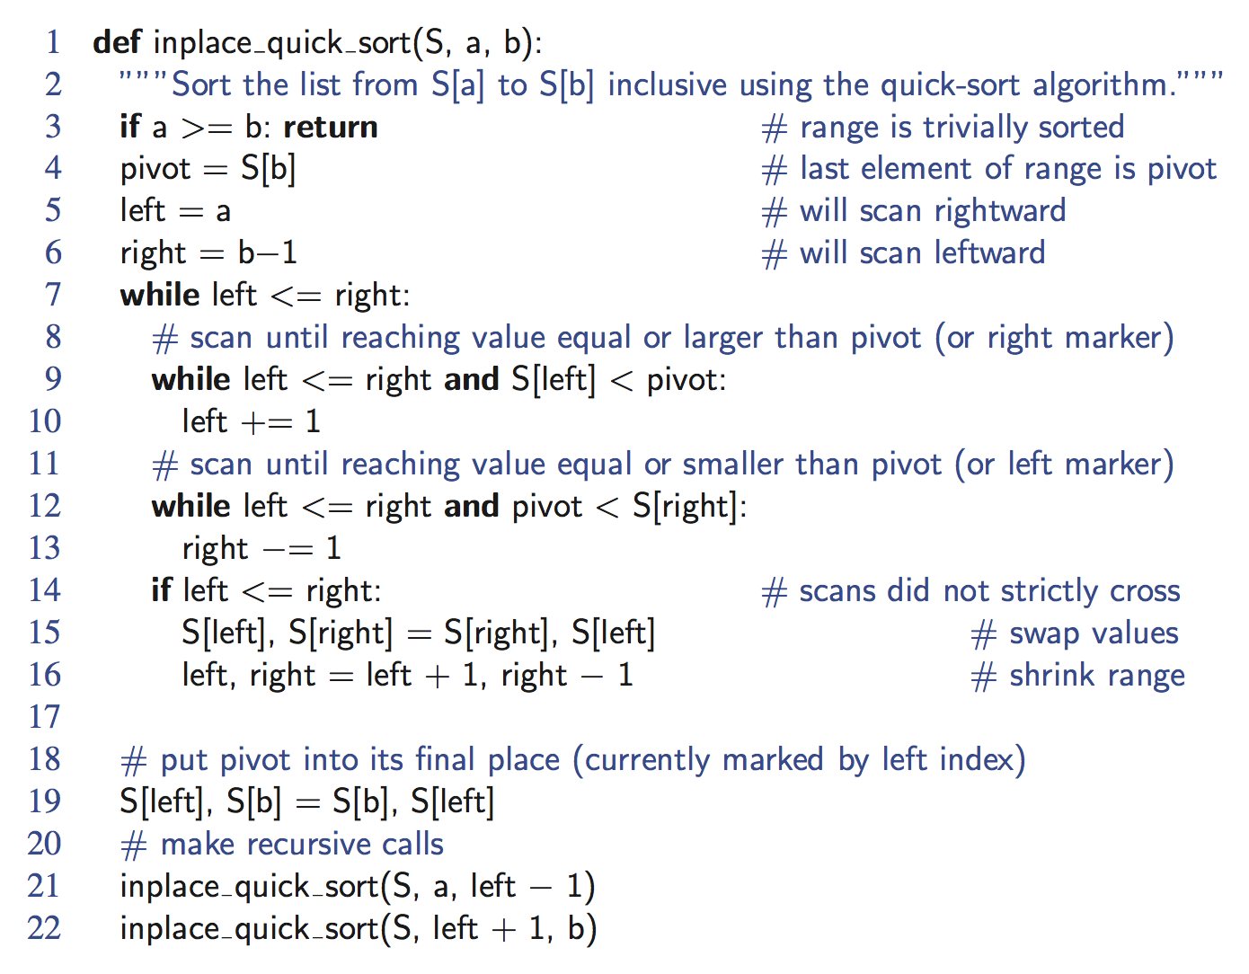
Python Implementation
Quick-Sort

Slide 33
Summary of Sorting Algorithms
Algorithm | Time | Notes
selection-sort | O(n²) | in-place slow (good for small inputs)
insertion-sort | O(n²) | in-place slow (good for small inputs)
quick-sort | O(n log n) expected | in-place, randomized fastest (good for large inputs)
heap-sort | O(n log n) | in-place fast (good for large inputs)
merge-sort | O(n log n) | sequential data access fast (good for huge inputs)
Quick-Sort

Slide 34
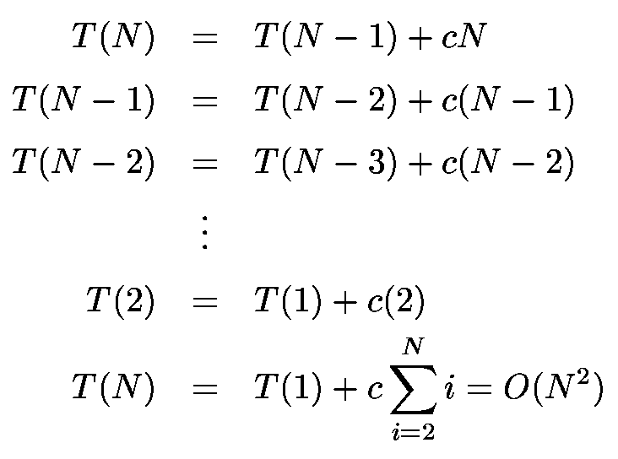
Worst-Case Analysis
What will be the worst case?
  The pivot is the smallest element, all the time
  Partition is always unbalanced

Slide 35
Best-case Analysis
  Partition is perfectly balanced
  Pivot is always in the middle
If the pivot “evenly” splits the partition, there will be log₂n levels, each of which requires O(n) comparisons
O(nlog₂n) time complexity

Slide 36
Dealing with small arrays
For small arrays (N ≤ 20),
  Insertion sort is faster than quicksort
Quicksort is recursive
  So it can spend a lot of time sorting small arrays
Hybrid algorithm:
  Switch to using insertion sort when problem size is small
  (say for N < 20)

Slide 37
Quick Sort – Summary
Divide and Conquer Algorithm
Most widely used sorting algorithm
    Possibly excluding those bubble sorts that should be banished!
Extremely efficient O(N log N)
Optimizations via pivot selection
Quicksort is fragile!
  Small mistakes can be hard to spot

Slide 38
BUCKET SORT & RADIX SORT

Slide 39
Time complexity of Sorting
Best sorting algorithms, so far:
  Merge sort: O( N log N )
  Quick sort (best one in practice)
    O( N log N ) on average
    O( N² ) worst case
Can we do better than O( n log n )?
  No
    Proven that any comparison-based sorting algorithm
    will need to carry out at least O( n log n ) operations

Slide 40
Restrictions on the problem
Assume that all unordered values have a limit
  e.g. values are digits from 0 to 9
Allows runtime better than O(N log N)!
  Strategy does not involve item comparisons

Slide 41
Bucket sort
Idea
  Suppose the values are in the range 0..m-1
  Start with m empty buckets numbered 0 to m-1
  Scan the list
  Every element of value s[i] goes in bucket s[i]
  Output the buckets in order
Requires an array of buckets
  Values in the unordered list = indexes to the buckets
  No item comparisons necessary

Slide 42

Example
Key range [0, 9]
7, d
1, c
3, a
7, g
3, b
7, e
Phase 1
1, c
3, a
3, b
7, d
7, g
7, e
B
0
1
2
3
4
5
6
7
8
9
∅
∅
∅
∅
∅
∅
∅
Phase 2
1, c
3, a
3, b
7, d
7, g
7, e
Bucket-Sort and Radix-Sort

Slide 43
Bucket Sort – Example
4 | 2 | 1 | 2 | 0 | 3 | 2 | 1 | 4 | 0 | 2 | 3 | 0
0 00
1 1
2
2 22
3 3
4 4
0 | 0 | 0 | 1 | 1 | 2 | 2 | 2 | 2 | 3 | 3 | 4 | 4

Slide 44
Values versus entries
Sorting values
  Each bucket is just a counter
  Scan a value => increment the matching counter
Sorting entries according to keys
  Each bucket is a queue
  Enqueue every entry into its matching bucket
  Dequeue all entries back into the array after the scan

Slide 45
Time complexity
Strictly speaking, time complexity is O (M+N)
  Bucket initialization: O(M)
  From array to buckets: O(N)
  From buckets to array: O(N)
M is likely to be small compared to N
=> Bucket sort is O(N)

Slide 46
Sorting integers
Restriction on value range is strong
  Number of buckets = Value range
  Time complexity is really O(M) when M >> N
  Sort 12 integers with maximum value 999999
  => requires 1 million buckets!
Can we do better?

Slide 47
Radix Sort
Idea
  Perform repeated bucket sorts by digit
  Start with the rightmost digit
  Only requires ten buckets
Good strategy when the keys are integers, and there is a reasonable limit on their values
Number of passes (bucket sort stages) still depends on the maximum value

Slide 48
Radix Sort Example
12 | 58 | 37 | 64 | 52 | 36 | 99 | 63 | 18 | 9 | 20 | 88 | 47
First Pass
20
52 12
63
64
36
47 37
88
18
58
99
9
20 | 12 | 52 | 63 | 64 | 36 | 37 | 47 | 58 | 18 | 88 | 9 | 99

Slide 49
Radix Sort Example
20 | 12 | 52 | 63 | 64 | 36 | 37 | 47 | 58 | 18 | 88 | 9 | 99
Second Pass
9
18
12
20
37
36
47
58 52
64
63
88
99
9 | 12 | 18 | 20 | 36 | 37 | 47 | 52 | 58 | 63 | 64 | 88 | 99

Slide 50
Radix Sort Example
12 | 58 | 37 | 64 | 52 | 36 | 99 | 63 | 18 | 9 | 20 | 88 | 47
First Pass
sort by rightmost digit
20 | 12 | 52 | 63 | 64 | 36 | 37 | 47 | 58 | 18 | 88 | 9 | 99
Second Pass
sort by leftmost digit
9 | 12 | 18 | 20 | 36 | 37 | 47 | 52 | 58 | 63 | 64 | 88 | 99

Slide 51
Radix Sort - Stability
Radix sort requires stable bucket sorts
  Stable sort: relative order of elements is preserved
  e.g. if first pass places 52 before 58, none of the ulterior passes will place 52 after 58
Easy to implement via queues

Slide 52
Time complexity
Strictly speaking, time complexity is O(PN)
  p is the number of digits
  (p = log₁₀m, where m is the maximum value in the list)
Assuming a fixed number p of bucket sort stages
Radix sort is O(N)

Slide 53
Summary
Bucket sort and Radix sort are O( n ) algorithms only because we have imposed restrictions on the input list to be sorted
Sorting, in general, can be done in
O( n log n ) time

Slide 54

Radix-Sort for Binary Numbers
Consider a sequence of n b-bit integers
x = x_{b − 1} … x₁x₀
We represent each element as a b-tuple of integers in the range [0, 1] and apply radix-sort with N = 2
This application of the radix-sort algorithm runs in O(bn) time
For example, we can sort a sequence of 32-bit integers in linear time
Algorithm binaryRadixSort(S)
Input sequence S of b-bit
integers
Output sequence S sorted
replace each element x
of S with the item (0, x)
for i ← 0 to b − 1
replace the key k of
each item (k, x) of S with bit x_{i} of x
bucketSort(S, 2)
Bucket-Sort and Radix-Sort

Slide 55
Example
Sorting a sequence of 4-bit integers
1001
0010
1001
1001
0001
0010
1110
1101
0001
0010
1101
1001
0001
0010
1001
0001
1101
0010
1101
1101
1110
0001
1110
1110
1110
Bucket-Sort and Radix-Sort

Slide 56
Select k-th smallest element
select the median element
  k = floor (n/2)
  k = 3, third smallest element
  Prune-and-search or decrease-and-search Strategy
Quick-Sort

Slide 57
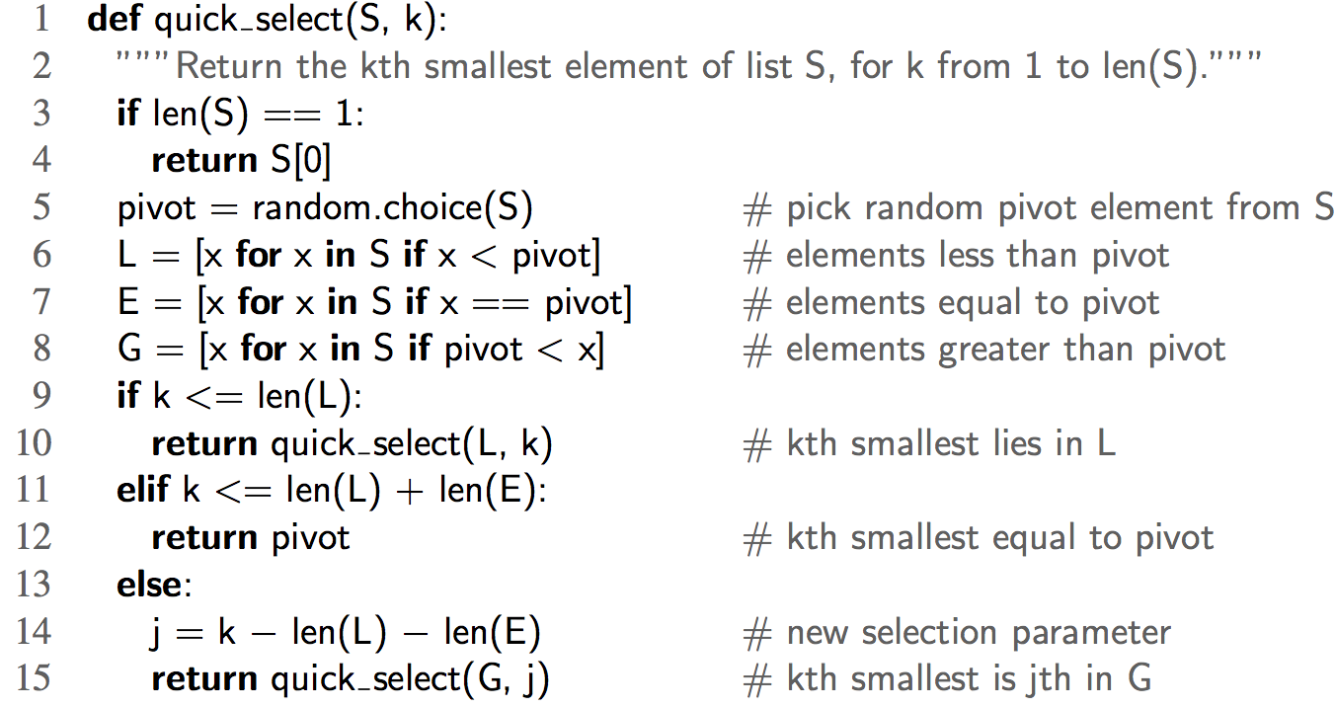
Randomized Quick Select
Quick-Sort

